Slide 1
Progress Report
4/22
HJ. Kwon
Progress Report
NCC-GCSP

Slide 2
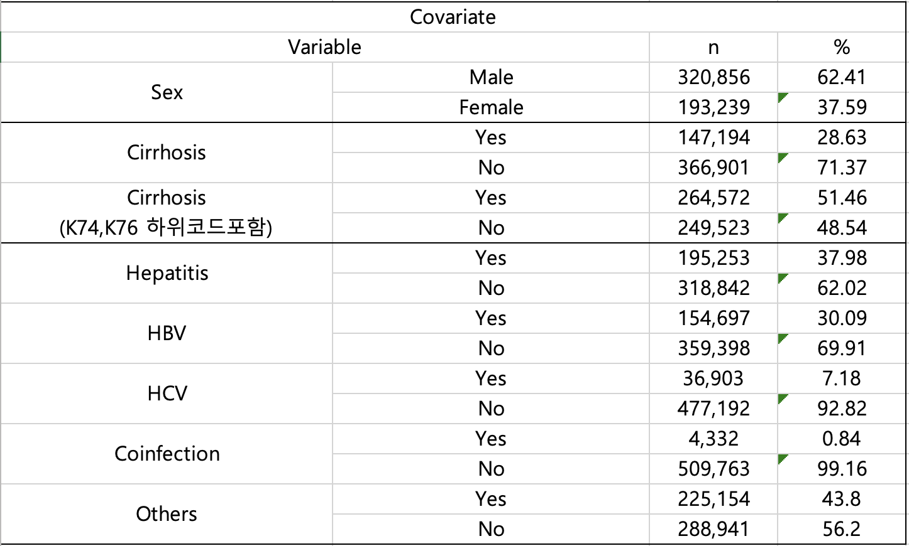
Descriptive Table
기존 모델의 Cirrhosis는 K74,K741,K742,K746,K76,K702,K703,K709 만 해당
약 30% 수치가 나타나 K74,K76 하위코드 포함하여 조사
→ 50%가까이 증가
포함되지 않아야 하는 상병코드에 대해서 추가 조사 및 상병코드 분포도 확인 예정
HJ. Kwon
Progress Report
NCC-GCSP

Slide 3
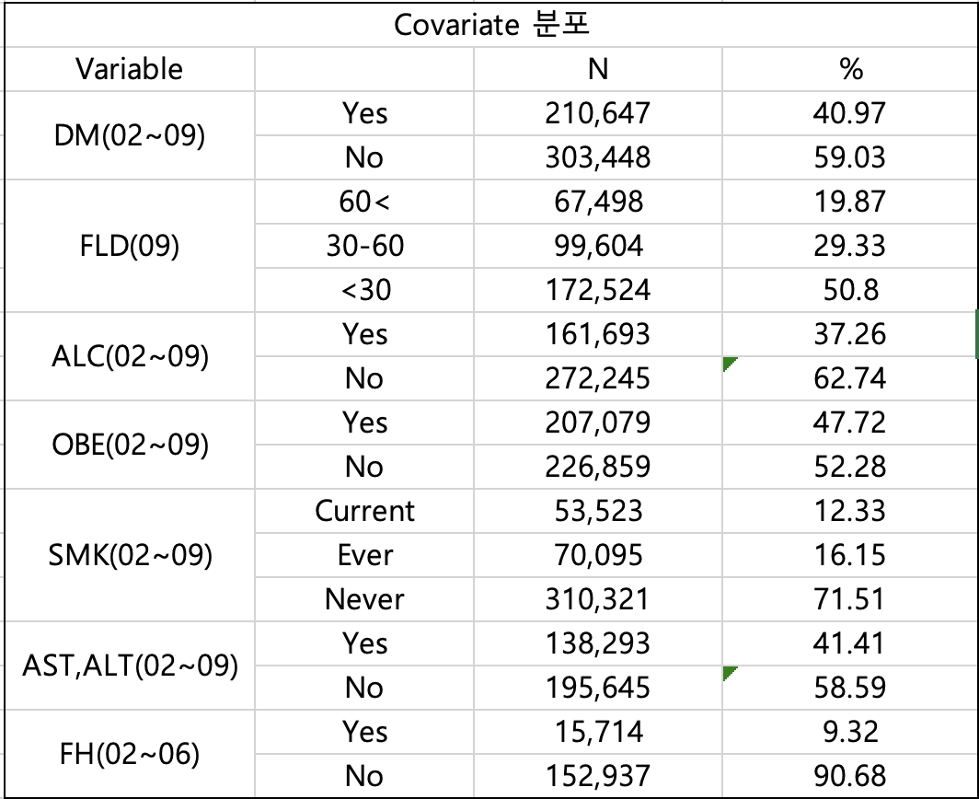
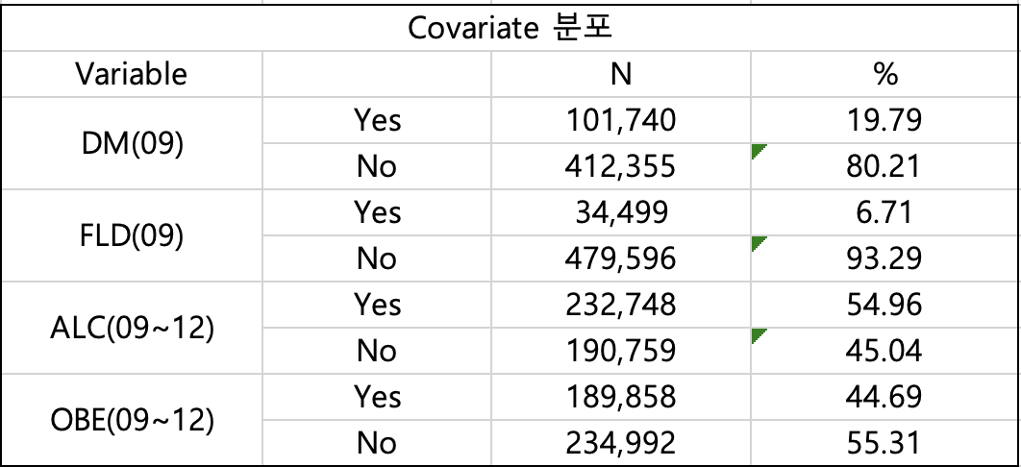
Descriptive Table
FLD의 경우 ~2007년도까지 WSTC,TG 수치 X
2008년도에는 WSTC 수치 X
추가적으로 성별 및 연령에 따른 분포도와 통계량 확인 예정
가족력의 경우 변수 명칭이 변경되어 추가 조사 예정
검진년도에 가장 가까운 기록을 바탕으로 재구축 예정
HJ. Kwon
Progress Report
NCC-GCSP

Slide 4
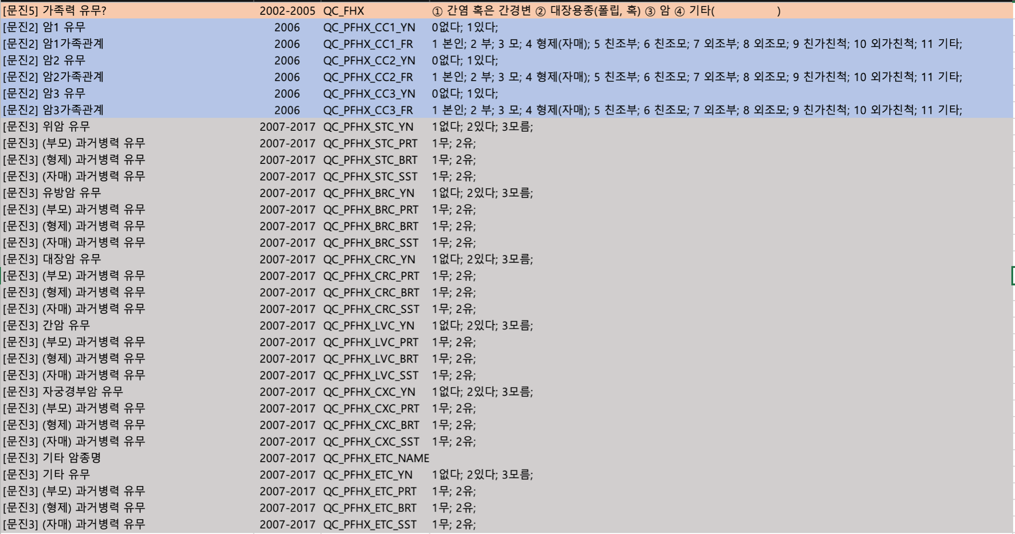
HJ. Kwon
Progress Report
NCC-GCSP

Slide 5
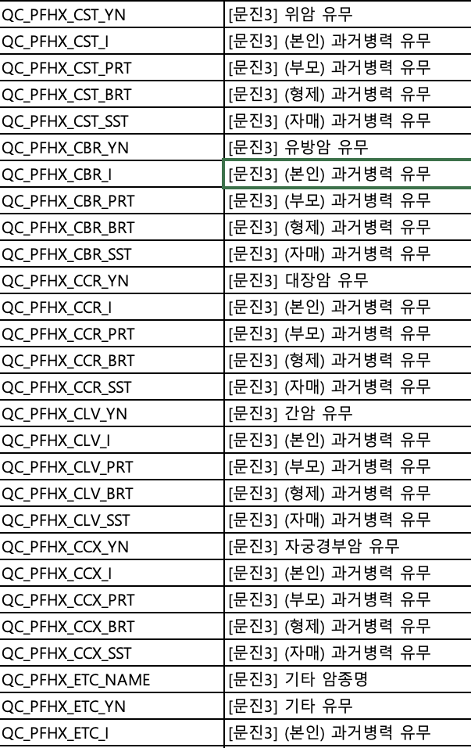
Variable Change
HJ. Kwon
Progress Report
NCC-GCSP

Slide 6
Time Interval Comparison - 3 state model
Standard : Year
Standard : Month
1 year | High | LVC | DEATH
High | 0.991 | 0.008 | 0.001
LVC | 0 | 0.787 | 0.208
DEATH | 0 | 0 | 1.000
12 month | High | LVC | DEATH
High | 0.844 | 0.0423 | 0.114
LVC | 0 | 0.039 | 0.961
DEATH | 0 | 0 | 1.000
Year → Month로 변경하여 cycle 주기를 증가시켰을 때 Transition Probability 차이 발생
Occur MLE error in R : initial in vmmin is no finite error
→ starting values is evaluating to a non-finite value (+/-Inf)
Cycle 임의로 변경시 발생할 수 있는 오류에 대해서 오류를 줄일 수 있는 방안에 대한 논문 Search
5 year | High | LVC | DEATH
High | 0.954 | 0.086 | 0.19
LVC | 0 | 0.302 | 0.687
DEATH | 0 | 0 | 1.000
60 month | High | LVC | DEATH
High | 0.427 | 0.023 | 0.55
LVC | 0 | 9.43e-08 | 1.000
DEATH | 0 | 0 | 1.000
HJ. Kwon
Progress Report
NCC-GCSP

Slide 7
Changing Cycle Lengths in State-Transition Models:
Challenges and Solutions
Jagpreet Chhatwal et.al
HJ. Kwon
Literature Review
NCC-GCSP

Slide 8
Background
If configured through the existing approach, errors occur in the cycle due to the change of time unit.
Sonnenberg and Beck(1), and Miller and Homan(2) warned against simply dividing the transition probabilities to shorter cycle when changing the cycle length. For example, when changing the cycle length from annual to monthly, one should not divide the transition probability by 12.
The objective of this study is to explore the issues involved when changing the length of the cycle in STMs, and to present an accurate and generalizable approach of converting model inputs (particularly, transition probabilities) to different cycle lengths.
1. Sonnenberg FA, Beck JR. Markov models in medical decision making a practical guide. Medical decision making. 1993; 13(4):322–38. [PubMed: 8246705]
2. Miller DK, Homan SM. Determining Transition Probabilities: Confusion and Suggestions. Medical Decision Making. 1994; 14(1):52–8. [PubMed: 8152357]
HJ. Kwon
Literature Review
NCC-GCSP

Slide 9
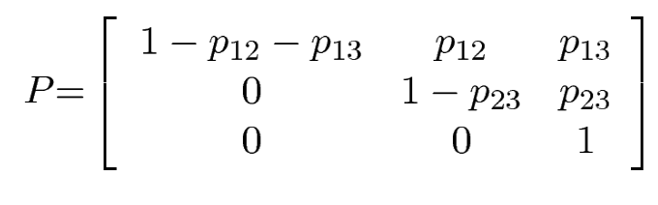
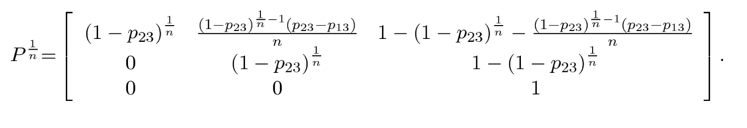
Analytical Approach for Eigendecomposition
Annual transition probability matrix
Annual transition probability matrix
HJ. Kwon
Literature Review
NCC-GCSP

Slide 10
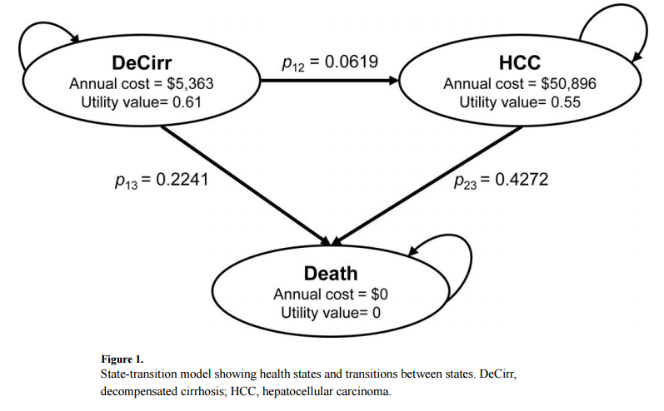
Error with traditional approach
By altering the Markov chain, the traditional approach introduces error (“conversion error”) in the model’s distribution of health states and outcomes.
To estimate the conversion error, we ran the model using a monthly-cycle length with both the traditional and eigendecomposition approach
HJ. Kwon
Literature Review
NCC-GCSP

Slide 11
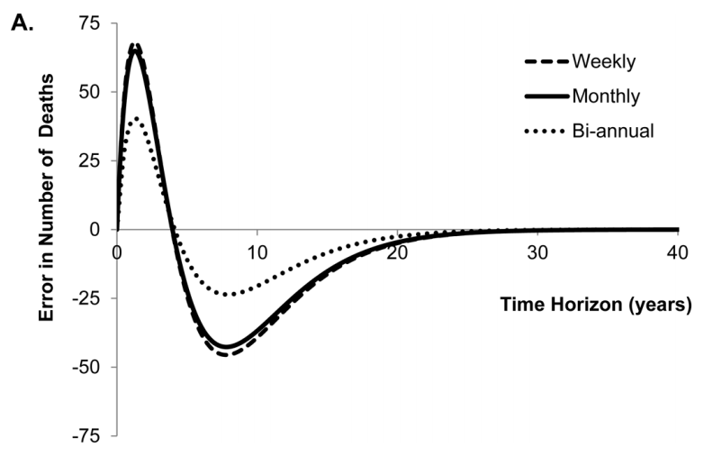
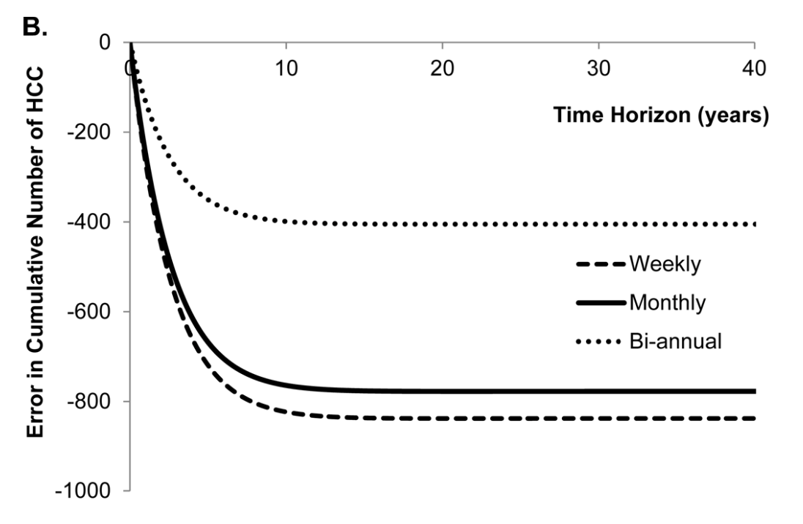
Error with traditional approach
The traditional approach overestimated (i.e. positive error) the number of deaths until year 4 and underestimated (i.e. negative error) the number of deaths afterwards using the monthly cycle length (Figure A). Second, the traditional approach underestimated the cumulative incidence of HCC, and the error monotonically increased with time (Figure B).
HJ. Kwon
Literature Review
NCC-GCSP

Slide 12
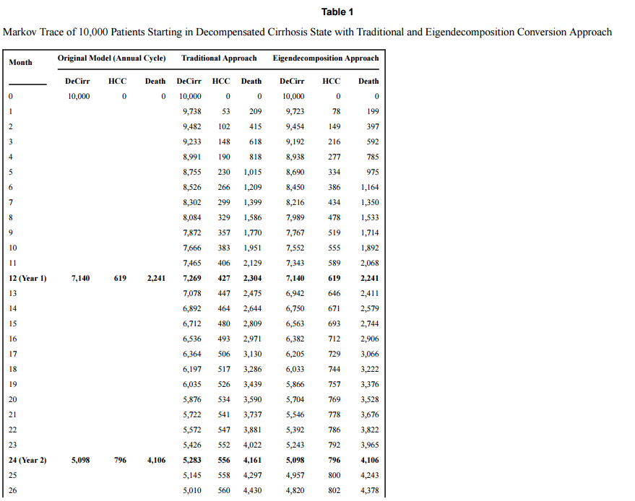
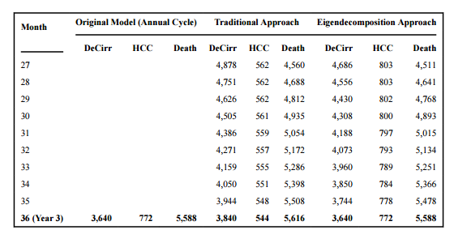
Error with traditional approach
The probability of death from DeCirr was overestimated and the probability of progressing to HCC was underestimated by the traditional approach.
HJ. Kwon
Literature Review
NCC-GCSP

Slide 13
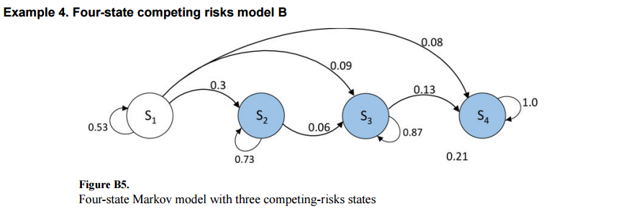
Competing Model for 4 state model
The eigendecomposition method provided a stochastic root, and there was no need for any numerical approximation. The error using our approach was 0%, whereas the error using the traditional approach was 5.13%.
HJ. Kwon
Literature Review
NCC-GCSP

Slide 14
Limitation & Summary
The issues of stochasticity, embeddability, and identifiability do not arise when increasing the cycle length of STMs to the multiple of the original cycle length.
However, when the cycle length is converted to a non-multiple (i.e. non-integer) value, the resulting matrix is not guaranteed to be stochastic when using the eigendecomposition approach.
Traditional method of converting transition probabilities to different cycle lengths is incorrect and can provide imprecise estimates of model outcomes.
Eigendecomposition is accurate approach that is based on finding the root of a transition probability matrix
HJ. Kwon
Literature Review
NCC-GCSP

Slide 15
Transitions in Prognostic Awareness Among Terminally Ill Cancer
Patients in Their Last 6 Months of Life Examined
by Multi-State Markov Modeling
CHEN HSIU CHEN et.al
HJ. Kwon
Literature Review
NCC-GCSP

Slide 16
Background
Understanding the transition probabilities and time spent in each prognostic-awareness state can help clinicians identify trigger points for facilitating transitions toward accurate prognostic awareness
Examining transition probabilities in distinct prognostic‐awareness states between consecutive time points in 247 cancer patients’ last 6 months and estimated the time spent in each state.
Prognostic awareness was categorized into four states: (a) unknown and not wanting to know, state 1; (b) unknown but wanting to know, state 2; (c) inaccurate awareness, state 3; and (d) accurate awareness, state 4.
HJ. Kwon
Literature Review
NCC-GCSP

Slide 17
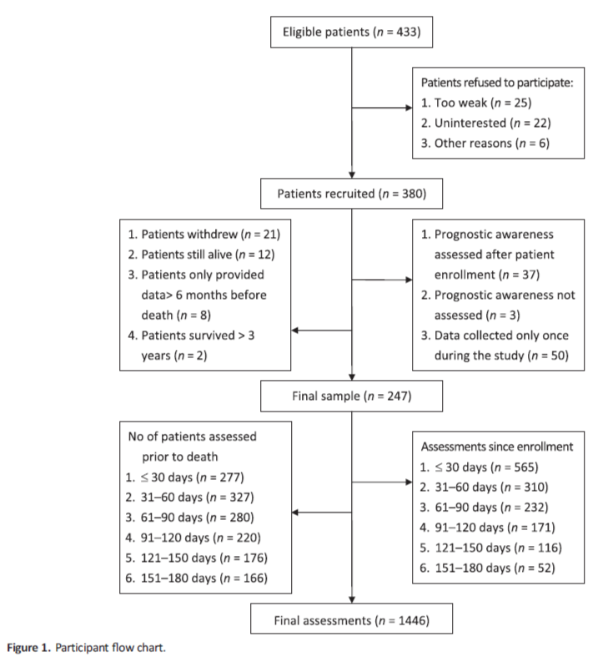
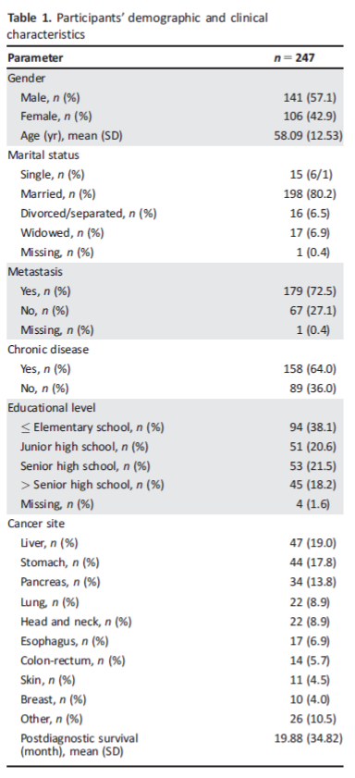
HJ. Kwon
Literature Review
NCC-GCSP

Slide 18
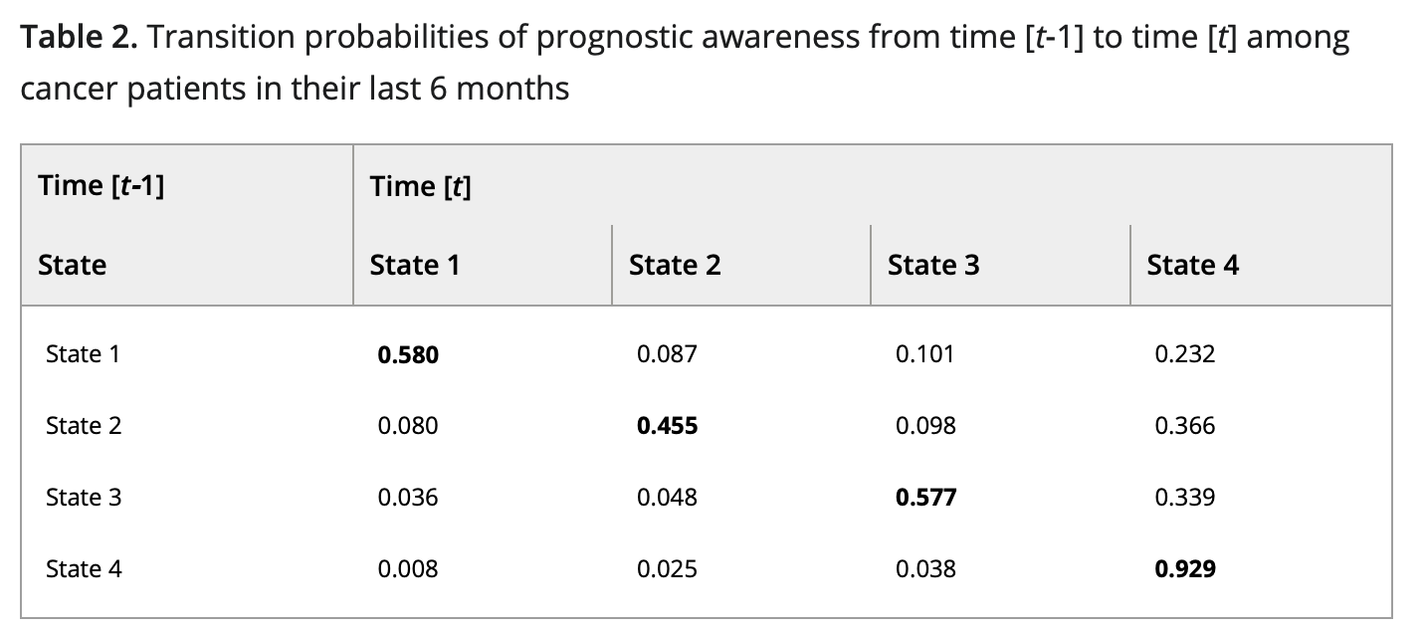
Prognostic - Awareness Transition Probability
Transition probabilities in distinct states of prognostic awareness between consecutive time points and the time spent in each state were estimated by multistate Markov modeling (MSM)
HJ. Kwon
Literature Review
NCC-GCSP

Slide 19
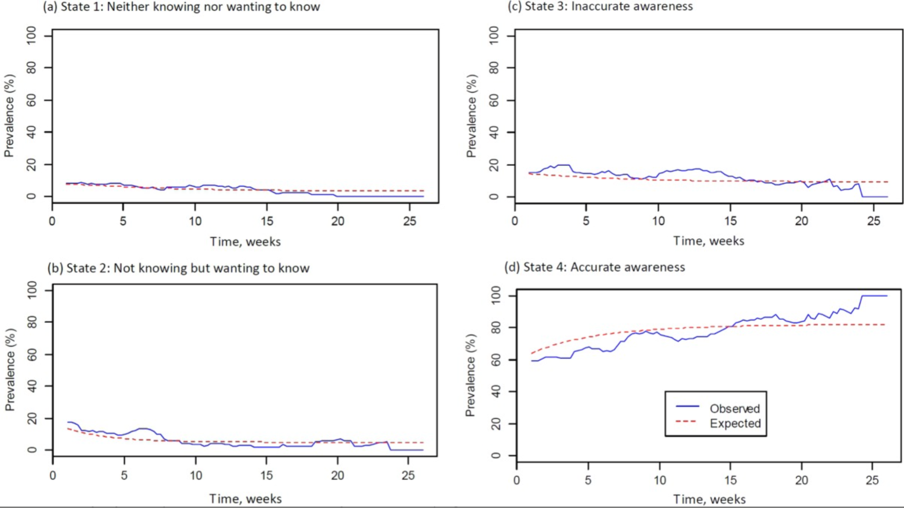
HJ. Kwon
Literature Review
NCC-GCSP

Slide 20
Summary
Terminally ill cancer patients’ prognostic awareness generally remained unchanged, with a tendency to become more aware of their prognosis.
HJ. Kwon
Literature Review
NCC-GCSP

